Slide 1



Municipality of Bar
  M A R I E
Barcelona, 25-26. May 2011.

Slide 2
Municipality of Bar
  M A R I E
Barcelona, 25-26. May 2011.

Slide 3
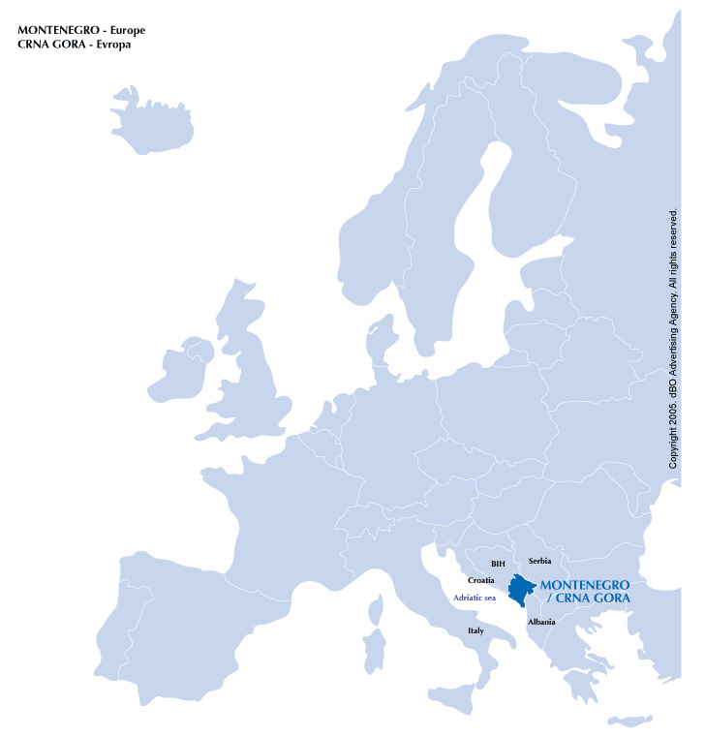


Municipality of Bar
Montenegro - overview
Area: 13,812 km²
Population: 625,266
Density of population: 50/km²

Slide 4
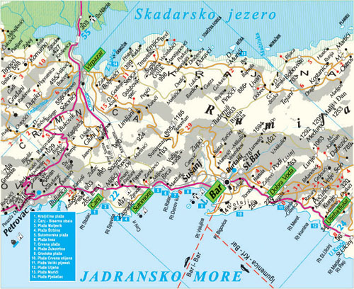
Municipality of Bar
Surface area: 505 km²
43.000 inhabitants
(45 % of inhabitants live in urban center, and the rest in other zones)
favorable geographical position:
- 45 km of the Adriatic coastline, of which 9,5 km of beaches;
- 67 km of Lake Skadar shore

Slide 5
EXCELLENT TRANSPORT CONNECTIONS
Situated close to two international airports: Podgorica (45km) and Tivat (60 km); 120 km far from the international airport of Dubrovnik (Croatia)
Ferry line, established in 1968, connects Bar with Bari and Ancona (Italy)
Railway road connects Bar with Podgorica, Belgrade (Serbia) and Budapest (Hungary)
Regional roads connect Bar with Montenegrin hinterland, Serbia, Croatia, Albania and Bosnia and Herzegovina

Slide 6
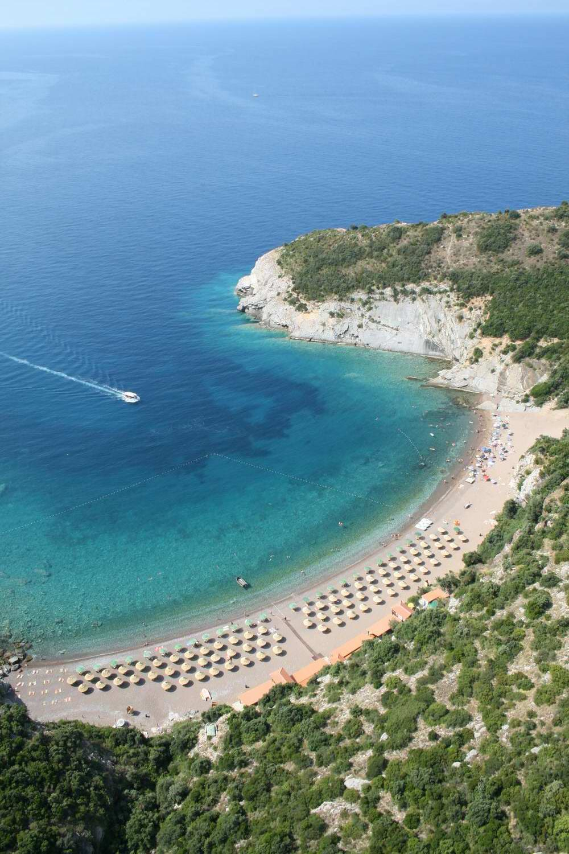
EXCELLENT WEATHER CONDITIONS
2500 sunny hours per year, (average 7 hours/day) average temperature 15.8˚C;
5 tourist sites
Tourism is priority economic sector: by 2020 there should be 30.000 beds in high class hotels and resorts
Numerous historical monuments and cultural manifestations

Slide 7
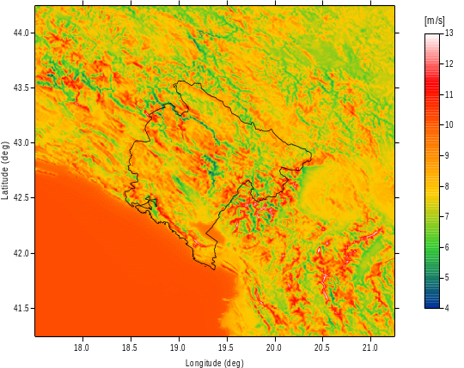
EXCELLENT WEATHER CONDITIONS
Typical values of the wind energy’s real potential amount to 100-300 W/m2, while in the most windy places this potential reaches the value of over 400 W/m2 (mount Rumija)
.
What has already been done
One wind farm of power of 46 MW (23 wind generators of 2 MW) is to be built on Možura. Urban plan has been adopted, the construction is to start this year.

Slide 8
What has been done in energy sector (legislation) on the national level
Energy Law was adopted in 2003.
Energy Regulatory Agency was Established in January 2004.
Energy Policy was adopted in February 2005.
Energy Efficiency Strategy was adopted in October 2005
Montenegro signed Energy Community Treaty in October 2005.
Strategy for Small Hydro Power Plants Development was adopted in April 2006.
Kyoto Protocol (ratified in March 2007)
Assessment of Renewable Energy Resources (wind, solar, biomass) (adopted in April 2007
Energy Development Strategy until 2025 is adopted in 2007.

Slide 9
Law on Energy Efficiency (adopted in May 2010, entered into force in May 2011)
Energy Efficiency Action Plan 2010-2012 (adopted in December 2010)
Preparation of relevant decrees and bylaws is underway.
Montenegro has very high energy savings potential (20%-30%).
In compliance with new regulations all Montenegrin municipalities have to increase energy efficiency and use of renewable energy sources as well as to:
Prepare Energy Efficiency Programs and Plans
Establish Municipal energy management system
Prepare energy savings projects of public buildings
Promote and perform energy audits

Slide 10
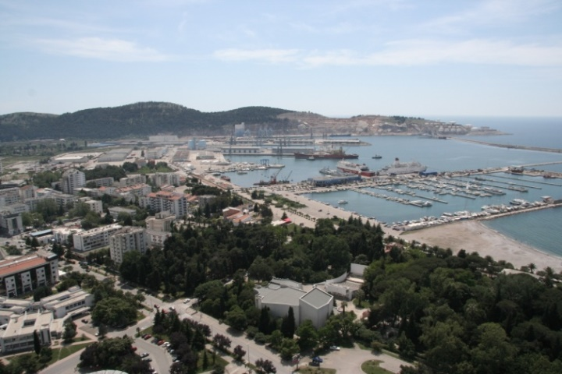
What has been done in building and urban planning sectors
in the Municipality of Bar
PLANNING DOCUMENTS
Apporved by the Government of Montenegro
- The Spatial Plan of Montenegro until 2020
- Special purpose Spatail Plan
- Detailed Spatial plan

Slide 11
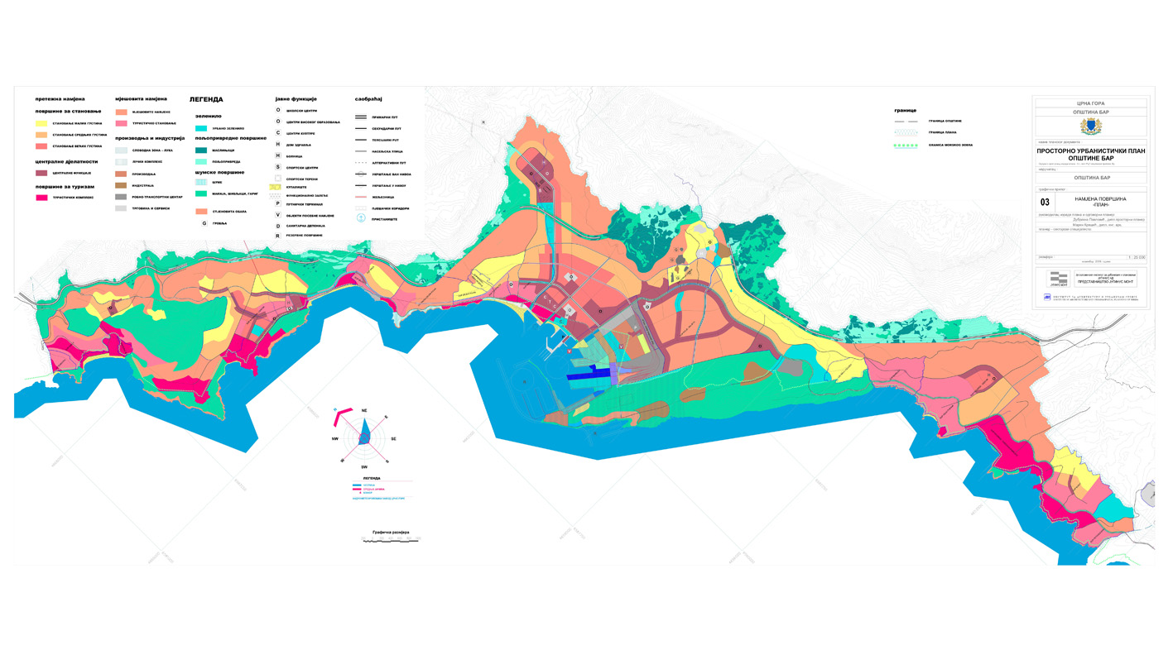
What is done in building and urban planning sectors
in the Municipality of Bar
Local planning documents:
- Spatial and urban plan of the Municipality of Bar (first draft is being prepared)
- General urban plan until 2020 (adopted in the 2007)
- Detailed urban plans ( total no. 26; 6 in central urban area)
- Urban design (total no. 23) and
- Local study of location (total no.13)

Slide 12
WP4 / PILOT ACTION 1.2 / PP 21
Through the MARIE project we expect to learn how to improve energy management. We plan to create an urban planning model which, upon completion of the project, can be disseminated applied in other areas of Montenegro which will enable sustainability of the project, but also sustainable development in coastal area of our country.
Expected outputs:
Energy Efficiency Improvement Program for the Municipality of Bar (for the period of three years)
Annual Energy Efficiency Improvement Plan for the Municipality of Bar (for implementation of the EE Improvement Program)

Slide 13
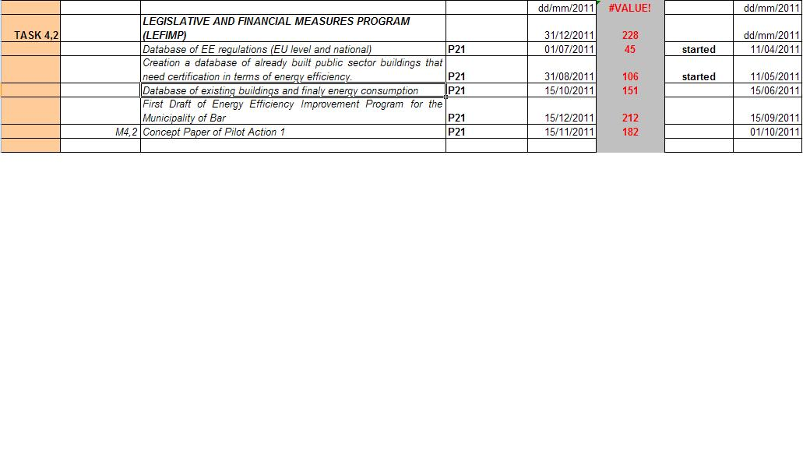
Year 2011
Creation of a database of all EU directives and strategies related to energy efficiency and comparative analysis with the actual Montenegrin (national and local) regulations.
Identification and creationof a database of already built public sector buildings which need certification in terms of energy efficiency (characteristics envelope of the buildings, materials property – aspect of energy efficient / sustainability)

Slide 14
Identify measures of energy efficiency to be applied in adaptation and maintenance of private buildings with a gross surface area bigger than 1 000 m²
Identify and prepare a database of potential renewable energy sources (RES) for the Municipality of Bar; identify and create a database of locally available construction material to be used for energy efficient development
Identify measures of energy efficiency to be applied in adaptation and maintenance of public buildings, new and existing one
Implementation of a pilot project ( preparation of a local urban plan with applied recommended energy efficiency measures ) to serve as a good practice example to other coastal municipalities

Slide 15
PILOT PROJECT
To be implemented within an existing detailed urban plan
Since there is no good quality data base containing the energy performance of buildings, the first goal is to determine the current situation of existing buildings .
It is necessary to create a Catalogue of building stocks of the city center in order to be able to identify improvement activities.
Define concrete activities aimed at improving energy efficiency of the selected part of the municipality

Slide 16
MUNICIPALITY OF BAR
Bulevar revolucije 1
85000 Bar
MONTENEGRO
tel. + 382 (0)30 301 406
fax + 382 (0)30 301 404
e-mail:sanja.stanisic@bar.me
web: www.bar.me

